Slide 1




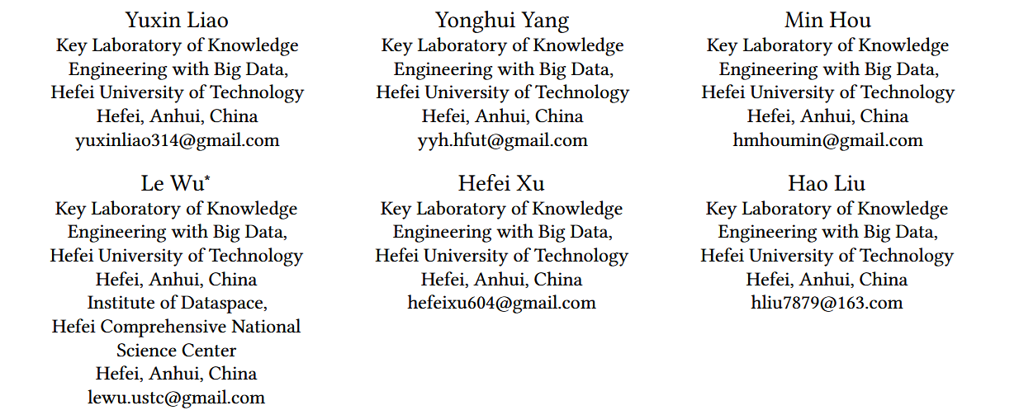





ATAI
Advanced Technique of Artificial Intelligence
ATAI
ChongqingUniversity _{AdvancedTechniqueof}
of Technology Artificial Intelligence
Chongqing University of
Technology
Chongqing University ^{ATAI}
_{of Technology} Advanced Techniqueof
Artificial Intelligence
Chongqing University of Technology
Chongqing University of Technology
Mitigating Distribution Shifts in Sequential Recommendation:
An Invariance Perspective
Code:https://github.com/hermione314/IDEA
——SIGIR_2025
Reported by Jingbo Liu
1

Slide 2
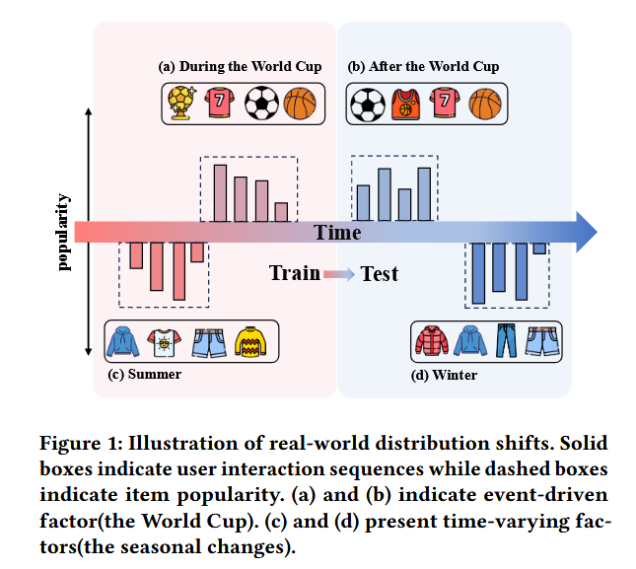
ATAI
Advanced Technique of Artificial Intelligence
ATAI
ChongqingUniversity _{AdvancedTechniqueof}
of Technology Artificial Intelligence
Chongqing University of
Technology
Chongqing University ^{ATAI}
_{of Technology} Advanced Techniqueof
Artificial Intelligence
Chongqing University of Technology
Chongqing University of Technology
Motivation
1) In real-world scenarios, time varying factors (e.g., product promotions, seasonal changes) induce distribution shifts in user interactions. Despite the demonstrated success of existing models, their generalization capability remains limited under such dynamic conditions.
2)Despite their effectiveness, DRO-based approaches are inherently constrained by the sparsity of training data, limiting the range of distributions they can model, while manually designed augmentations risk introducing noise or irrelevant information that could distort user preference learning

Slide 3
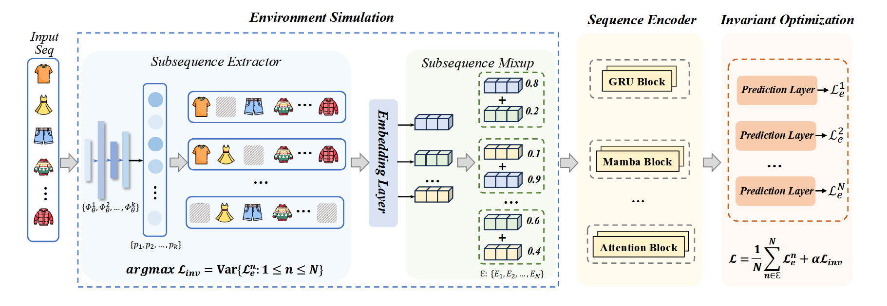
ATAI
Advanced Technique of Artificial Intelligence
ATAI
ChongqingUniversity _{AdvancedTechniqueof}
of Technology Artificial Intelligence
Chongqing University of
Technology
Chongqing University ^{ATAI}
_{of Technology} Advanced Techniqueof
Artificial Intelligence
Chongqing University of Technology
Chongqing University of Technology
Method

Slide 4
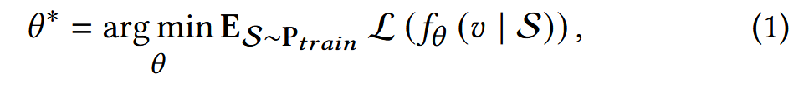
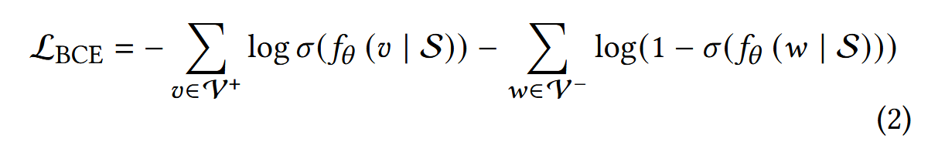

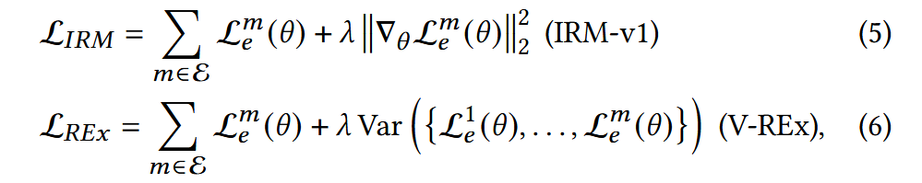
ATAI
Advanced Technique of Artificial Intelligence
ATAI
ChongqingUniversity _{AdvancedTechniqueof}
of Technology Artificial Intelligence
Chongqing University of
Technology
Chongqing University ^{ATAI}
_{of Technology} Advanced Techniqueof
Artificial Intelligence
Chongqing University of Technology
Chongqing University of Technology
Method

Slide 5

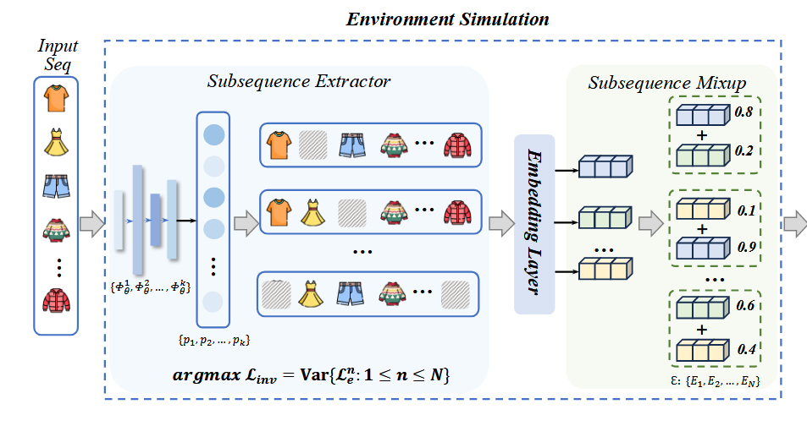



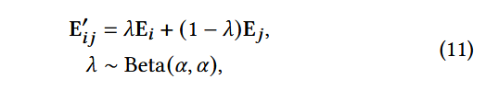
ATAI
Advanced Technique of Artificial Intelligence
ATAI
ChongqingUniversity _{AdvancedTechniqueof}
of Technology Artificial Intelligence
Chongqing University of
Technology
Chongqing University ^{ATAI}
_{of Technology} Advanced Techniqueof
Artificial Intelligence
Chongqing University of Technology
Chongqing University of Technology
Method

Slide 6
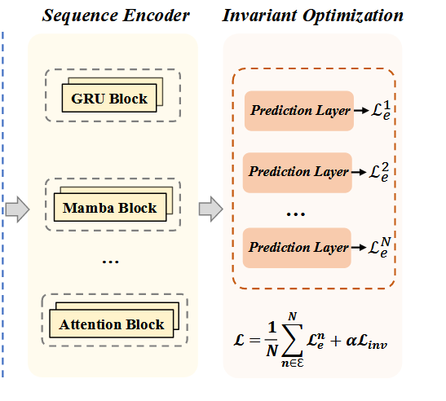

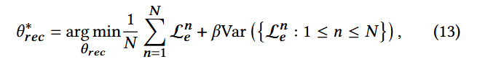

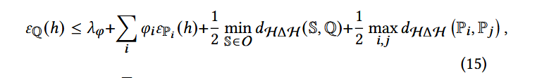
ATAI
Advanced Technique of Artificial Intelligence
ATAI
ChongqingUniversity _{AdvancedTechniqueof}
of Technology Artificial Intelligence
Chongqing University of
Technology
Chongqing University ^{ATAI}
_{of Technology} Advanced Techniqueof
Artificial Intelligence
Chongqing University of Technology
Chongqing University of Technology
Method

Slide 7
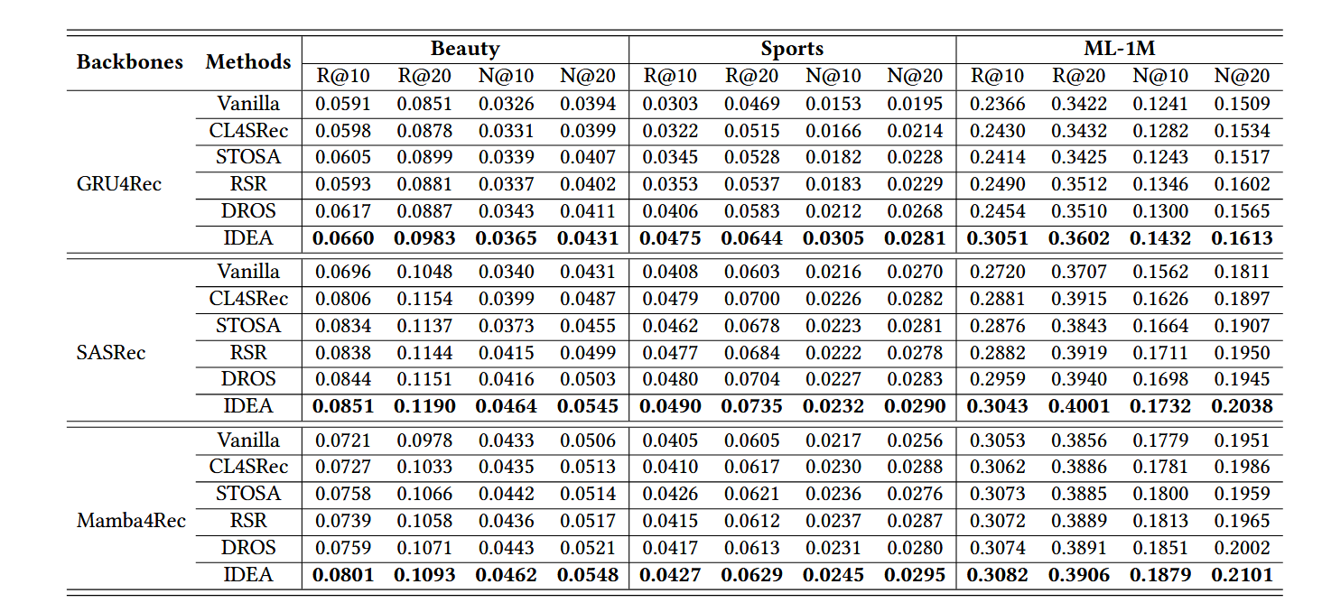
ATAI
Advanced Technique of Artificial Intelligence
ATAI
ChongqingUniversity _{AdvancedTechniqueof}
of Technology Artificial Intelligence
Chongqing University of
Technology
Chongqing University ^{ATAI}
_{of Technology} Advanced Techniqueof
Artificial Intelligence
Chongqing University of Technology
Chongqing University of Technology
Experiments

Slide 8
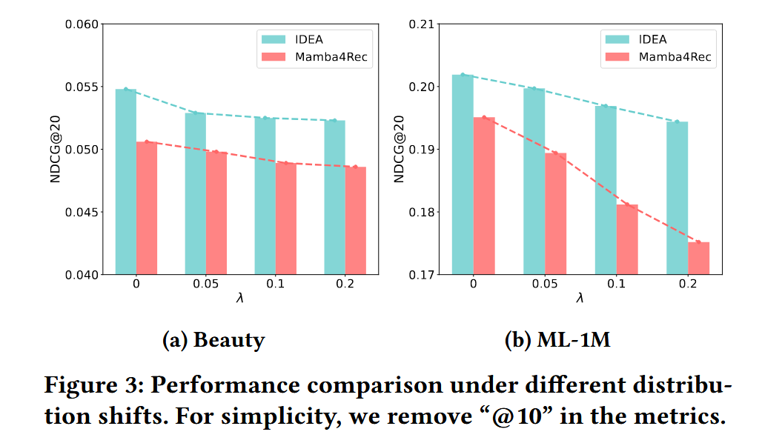
ATAI
Advanced Technique of Artificial Intelligence
ATAI
ChongqingUniversity _{AdvancedTechniqueof}
of Technology Artificial Intelligence
Chongqing University of
Technology
Chongqing University ^{ATAI}
_{of Technology} Advanced Techniqueof
Artificial Intelligence
Chongqing University of Technology
Chongqing University of Technology
Experiments

Slide 9

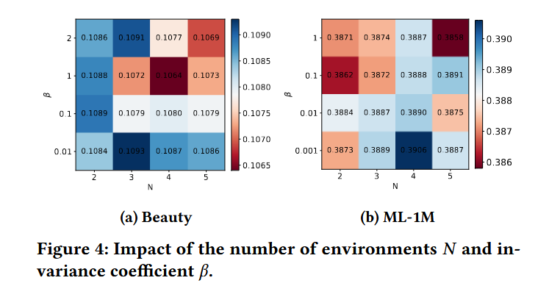
ATAI
Advanced Technique of Artificial Intelligence
ATAI
ChongqingUniversity _{AdvancedTechniqueof}
of Technology Artificial Intelligence
Chongqing University of
Technology
Chongqing University ^{ATAI}
_{of Technology} Advanced Techniqueof
Artificial Intelligence
Chongqing University of Technology
Chongqing University of Technology

Slide 10
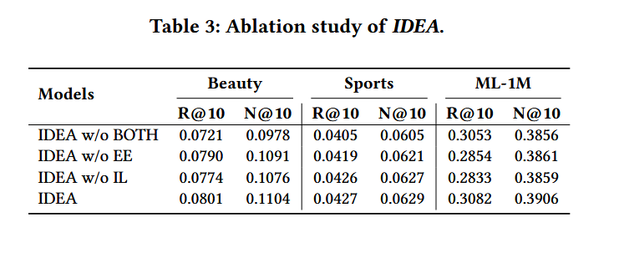
ATAI
Advanced Technique of Artificial Intelligence
ATAI
ChongqingUniversity _{AdvancedTechniqueof}
of Technology Artificial Intelligence
Chongqing University of
Technology
Chongqing University ^{ATAI}
_{of Technology} Advanced Techniqueof
Artificial Intelligence
Chongqing University of Technology
Chongqing University of Technology

Slide 11


ATAI
Advanced Technique of Artificial Intelligence
ATAI
ChongqingUniversity _{AdvancedTechniqueof}
of Technology Artificial Intelligence
Chongqing University of
Technology
Chongqing University ^{ATAI}
_{of Technology} Advanced Techniqueof
Artificial Intelligence
Chongqing University of Technology
Chongqing University of Technology
Thanks!

